Slide 1
Hand Rehabilitation App
Brandon Shepard, Joseph Yang, Kody Fitch, Martin Soto
February 6, 2019

Slide 2
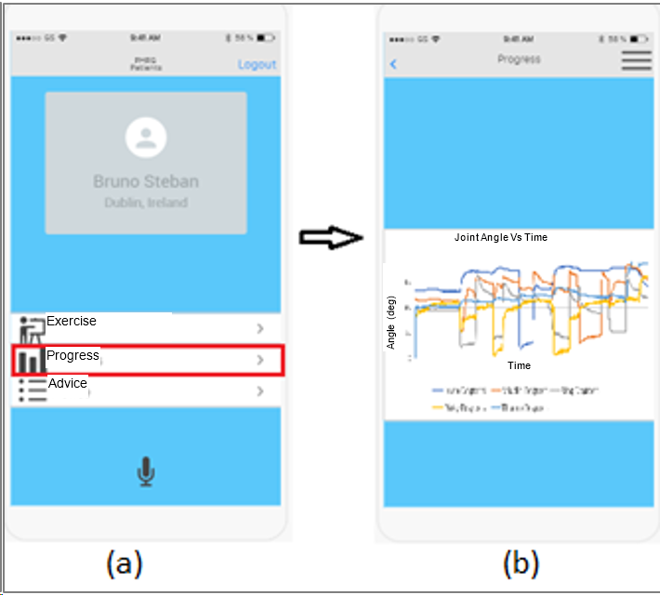
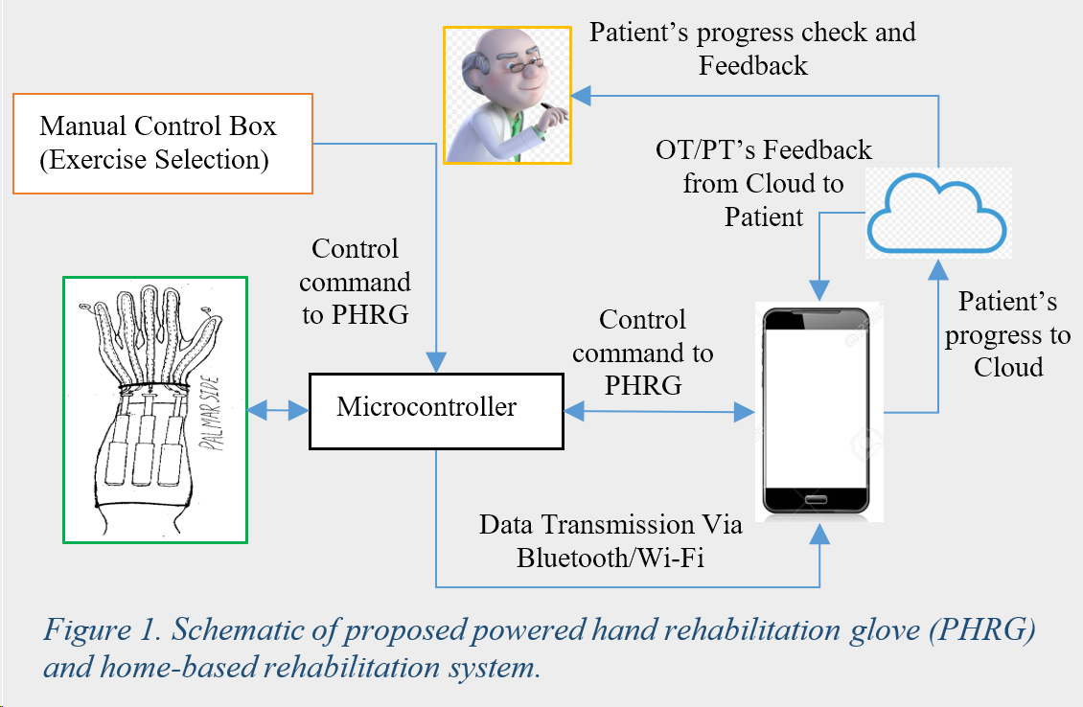
Grand Vision
A medical technology that allows patients to rehabilitate hand injuries via smartphone application.
Long Term
Apply to other parts of the body
Automatic analysis of data

Slide 3
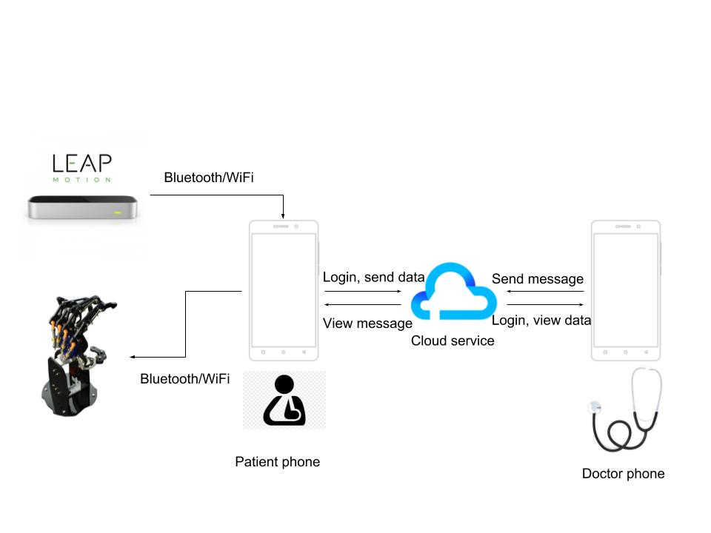
Semester Goals
Using a leap motion hand sensor, develop a smartphone application that allows a patients to rehabilitate hand injuries.

Slide 4


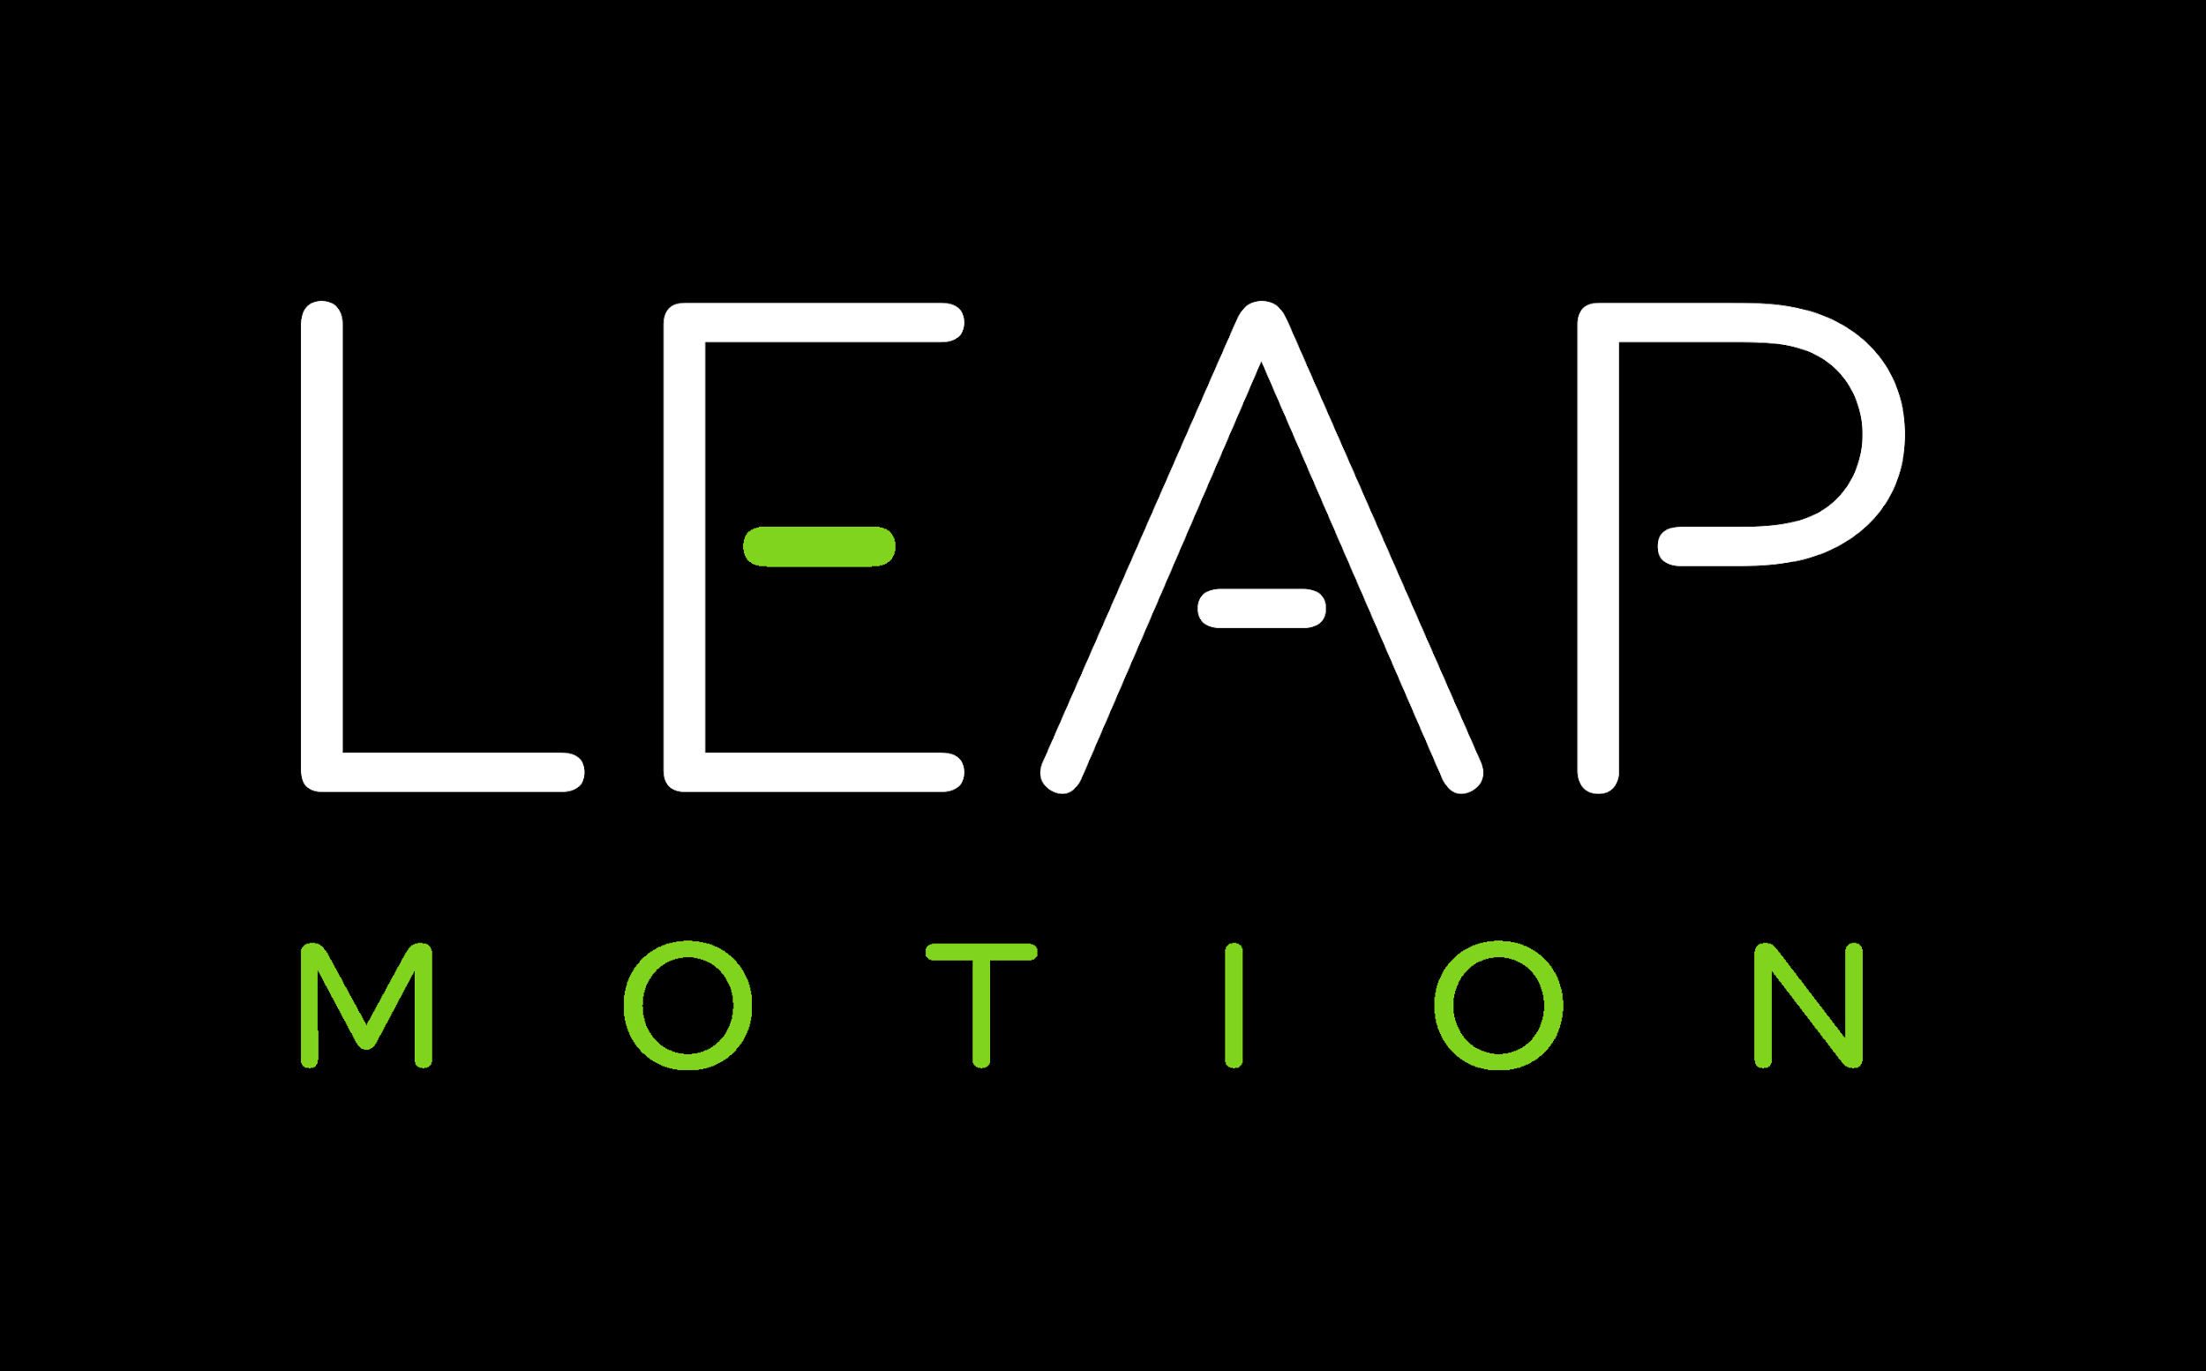
Technologies
Ionic framework
Based on AngularJS
Hybrid app (native/web combo)
Platform agnostic (iOS, Android, etc)
LEAP motion
Sensor platform
Communicates hand and finger motion
Interface between hand and app
Cloud service (TBD)
For communication between patient & doctor

Slide 5
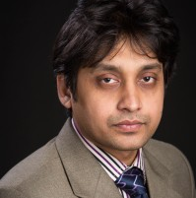
The Fantastic Four
Member: Kody Fitch
Fun fact: Every family member from my grandpa to me has the initials “KDF”
Member: Brandon Shepard
Fun fact: I prefer tabs over spaces.
Member: Martin Soto
Fun fact: I have the same birthday as my older sister
Member: Joseph Yang
Fun fact: My middle name is
literally “T”
Supervisor: Professor Mohammad Rahman
Director of BioRobotics Lab

